Slide 1
Pseudo Classes in CSS
By: Parul Madan(AP)
CSE(GEU)

Slide 2
What are Pseudo-classes?
A pseudo-class is used to define a special state of an element.
For example, it can be used to:
Style an element when a user mouse over it
Style visited and unvisited links differently
Style an element when it gets focus
Syntax:
selector: pseudo-class { property: value; }

Slide 3
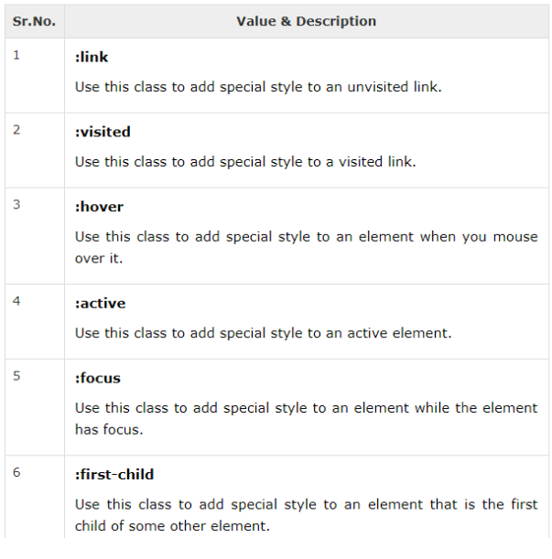

Slide 4
Examples
<style type = "text/css">
a:link {color: blue;}
a:visited{color:red;}
a:hover{color:pink;}
a:focus{color:green;}
a:active{color: black;}
</style>
<a href = " b.html">THIS WILL MOVE TO NEXRT PAGE</a>

Slide 5
:first-child
<!DOCTYPE html>
<html>
<head>
<style>
p:first-child {
color: blue;
}
</style>
</head>
<body>
<p>This is some text.</p>
<p>This is some text.</p>
</body>
</html>

Slide 6
:lang
<html>
<head>
<style type = "text/css">
/* Two levels of quotes for two languages*/
:lang(en) { quotes: '"' '"' "'" "'"; }
:lang(fr) { quotes: "<<" ">>" "<" ">"; }
</style>
</head>
<body>
<p>...<q lang = "en">A quote in a paragraph</q>...</p>
</body>
</html>

Slide 7
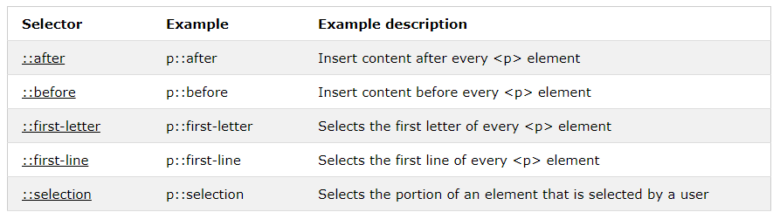
CSS Pseudo Elements

Slide 8
::before (will place some content before element selector)
<!DOCTYPE html>
<html>
<head>
<style>
p::before {
content: "this is it";
background-color: yellow;
color: red;
font-weight: bold;
}
</style>
</head>
<body>
<p>My name is Donald</p>
<p>I live in Ducksburg</p>

Slide 9
::after(will place some content after element selector)
<!DOCTYPE html>
<html>
<head>
<style>
p::after {
content: "this is it";
background-color: yellow;
color: red;
font-weight: bold;
}
</style>
</head>
<body>
<p>My name is Donald</p>
<p>I live in Ducksburg</p>

Slide 10
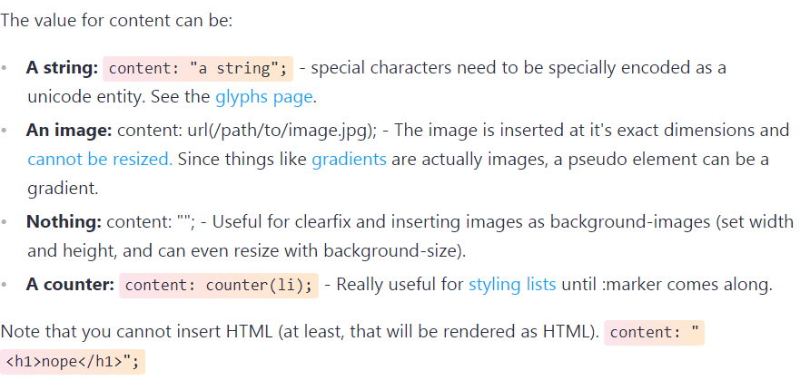

Slide 11
::first-line
<!DOCTYPE html>
<html>
<head>
<style>
p::first-line {
background-color: yellow;
}
</style>
</head>
<body>
<h1>WWF's Mission Statement</h1>
<p>To stop the degradation of the planet's natural environment and to build a future in which humans live in harmony with nature, by; conserving the world's biological diversity, ensuring that the use of renewable natural resources is sustainable, and promoting the reduction of pollution and wasteful consumption.</p>
</body>
</html>

Slide 12
::selection
<!DOCTYPE html>
<html>
<head>
<style>
::selection {
color: red;
background: yellow;
}
</style>
</head>
<body>
<h1>Select some text on this page:</h1>
<p>This is a paragraph.</p>
<div>This is some text in a div element.</div>
</body>
</html>

Slide 13
::first-letter
<!DOCTYPE html>
<html>
<head>
<style>
p::first-letter {
font-size: 200%;
color: #8A2BE2;
}
</style>
</head>
<body>
<h1>Welcome to My Homepage</h1>
<p>My name is Donald.</p>
<p>I live in Duckburg.</p>
<p>My best friend is Mickey.</p>
</body>
</html>

Slide 14
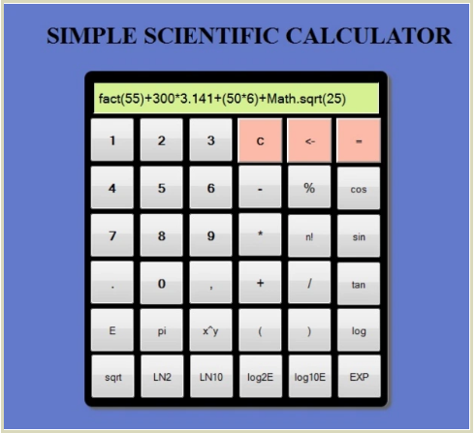

Slide 15
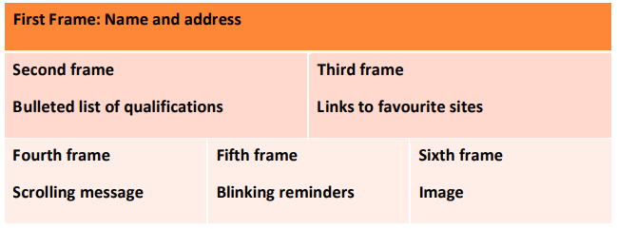

Slide 16
